Slide 1
Descripciones Fisicas de Celebridades
Physical Descriptions
in Spanish

Slide 2
Please go to Senorita Chad’s website (under 4th grade resources) and click on
DESCRIPCIONES FISICAS DE CELEBRIDADES. PPT
View the powerpoint to see each celebrity.
Please write 3-4 sentences to describe each celebrity.
Sentences may be about his/her name, eye color, hair color, hair length, hair style or profession.
We will use these sentences to play a round of Guess Who in a future class.
All sentences must be in complete sentences in SPANISH!
Some useful words [which can be found on 4th grade resources under Study Guide of Descriptions.pdf]:
rubio | marrón/ marrones | castaño | castaño rojizo | negro
rojo | gris | blanco | calvo/calva | de punta
liso | rizado | ondulado | largo | corto
hasta los hombros | verdes | azules | de color avellana | es un chico/ es una chica
lentes | barba | bigote | pecas | tiene

Slide 3
Selena Gomez

Slide 4
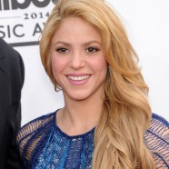
Shakira

Slide 5
Cameron Diaz

Slide 6
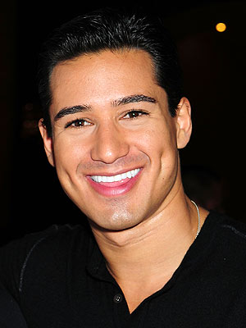
Mario Lopez

Slide 7
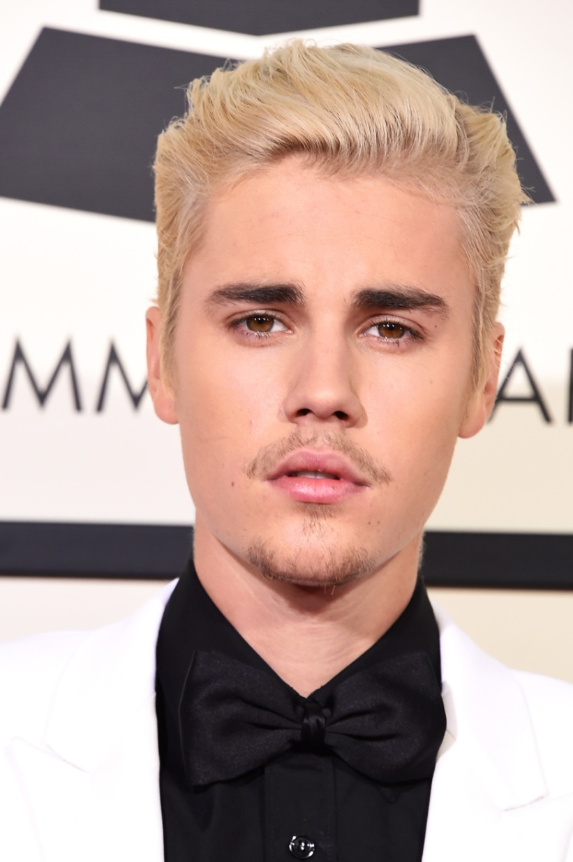
Justin Bieber

Slide 8
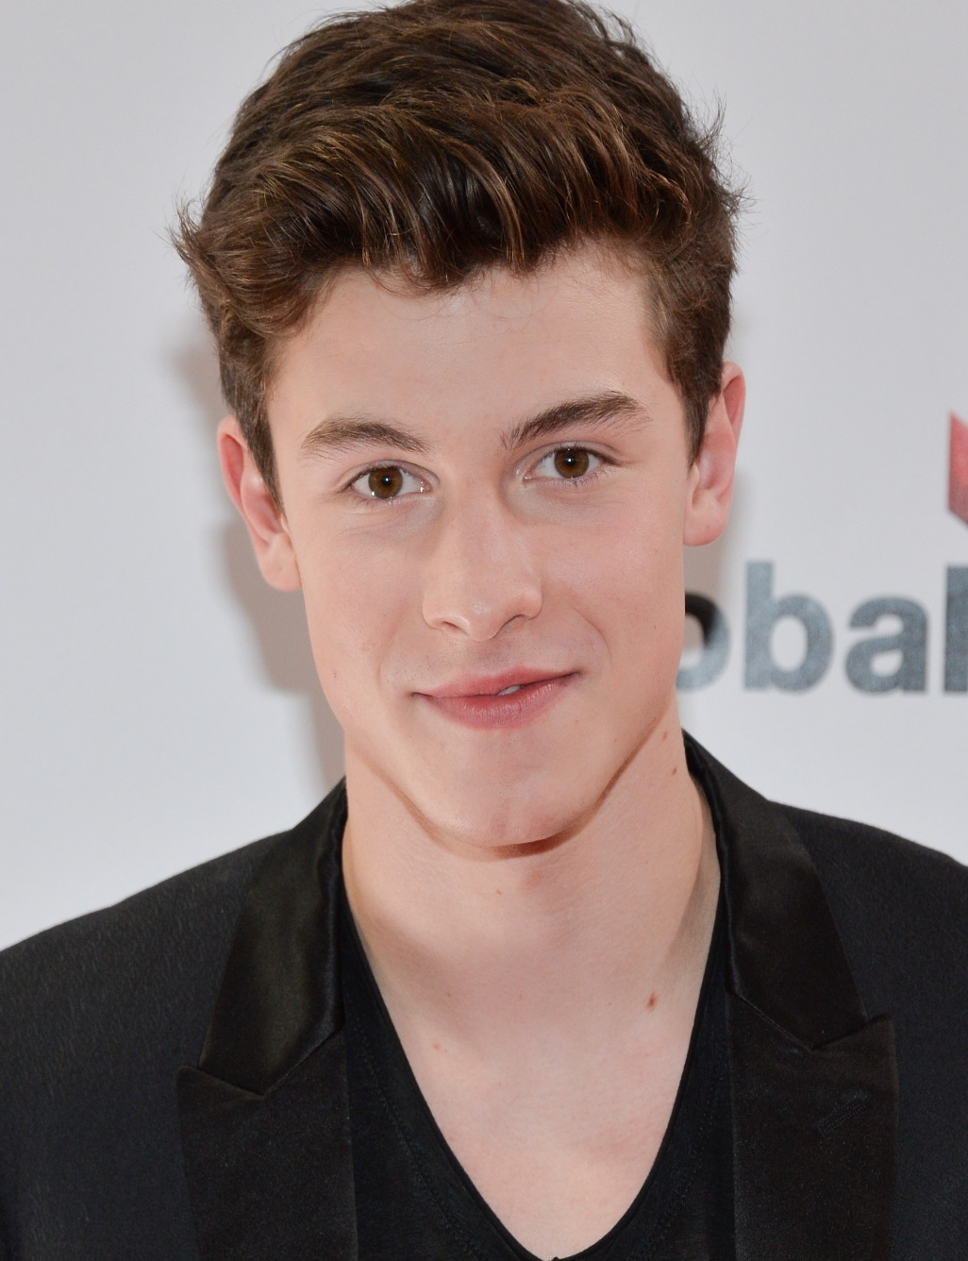
Shawn Mendes

Slide 9
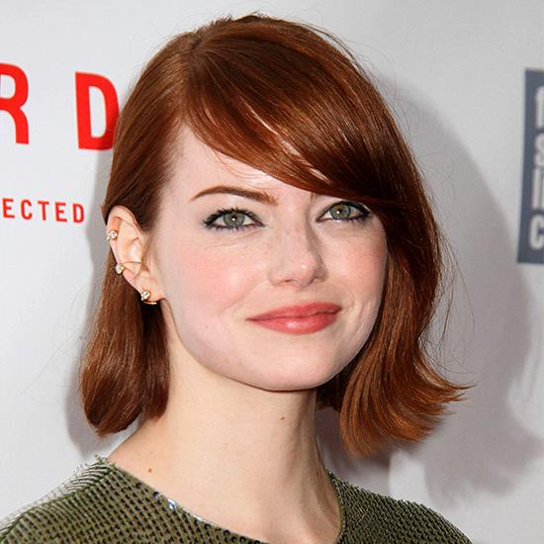
Emma Stone

Slide 10
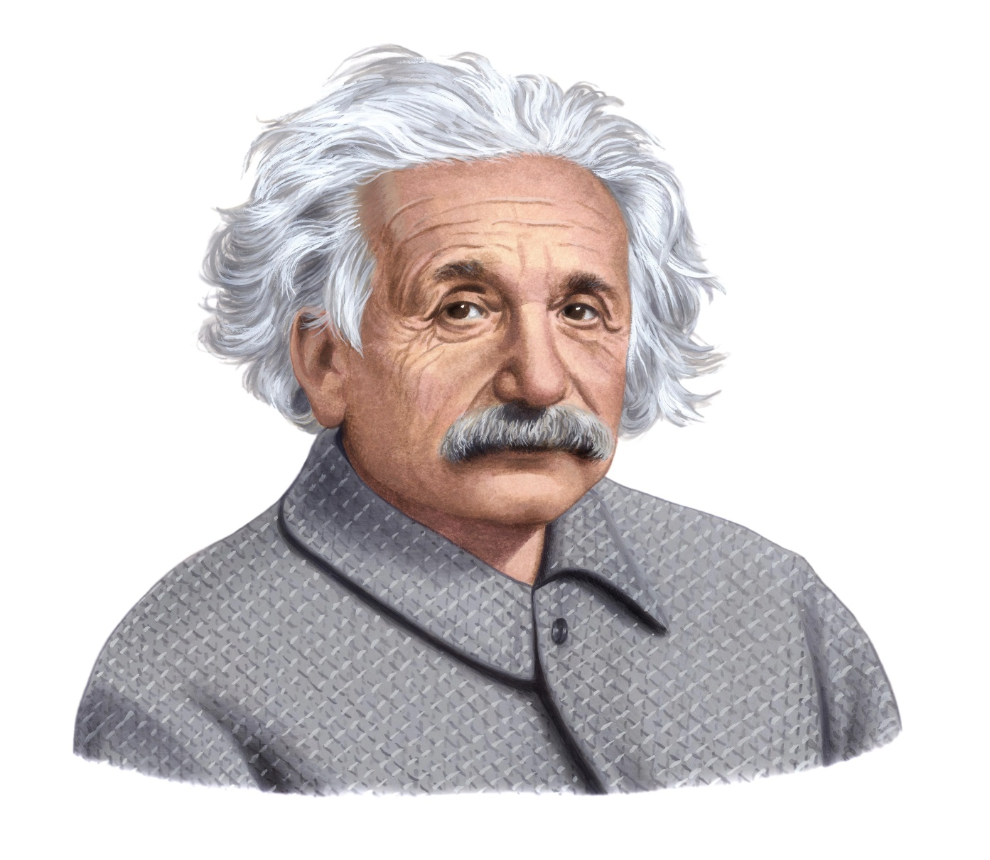
Albert Einstein

Slide 11
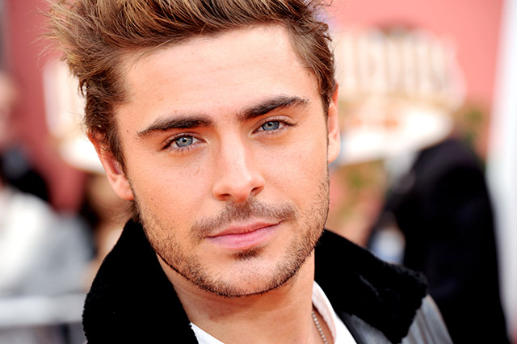
Zac Efron

Slide 12
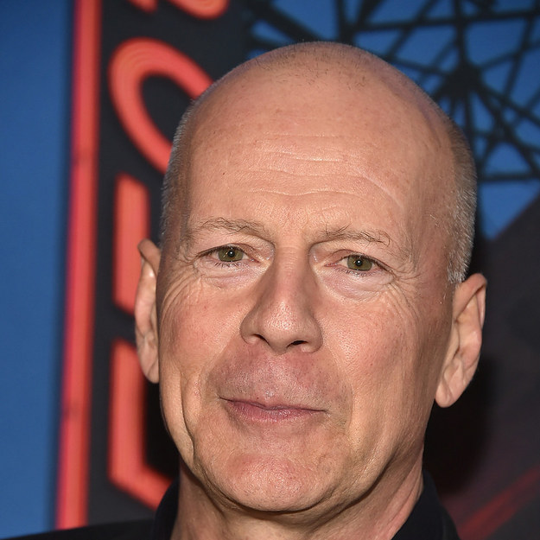
Bruce Willis

Slide 13
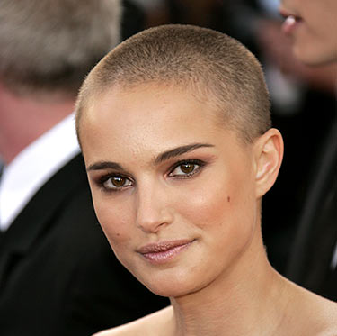
Natalie Portman

Slide 14
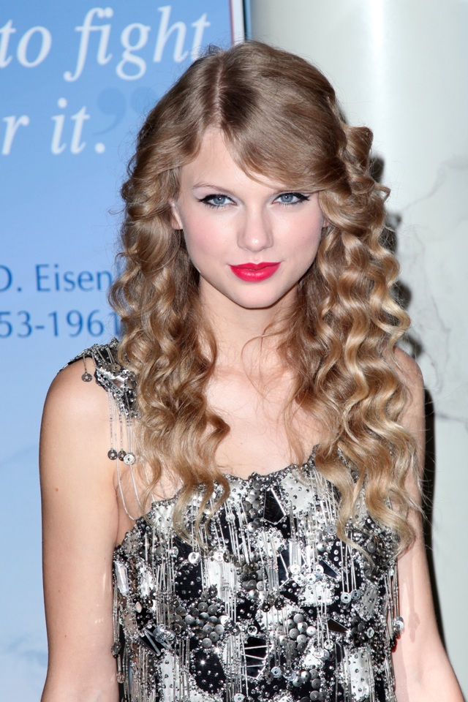
Taylor Swift

